Slide 1
Generative AI in Organisations: Challenges and Opportunities
ODSC Europe 2023 – Heiko Hotz

Slide 2
Agenda
What is Generative AI & how does it work?
How to use Large Language Models (LLMs)?
Demo: Chat with your document
Bias and ethics in Generative AI

Slide 3
What is Generative AI?

Slide 4
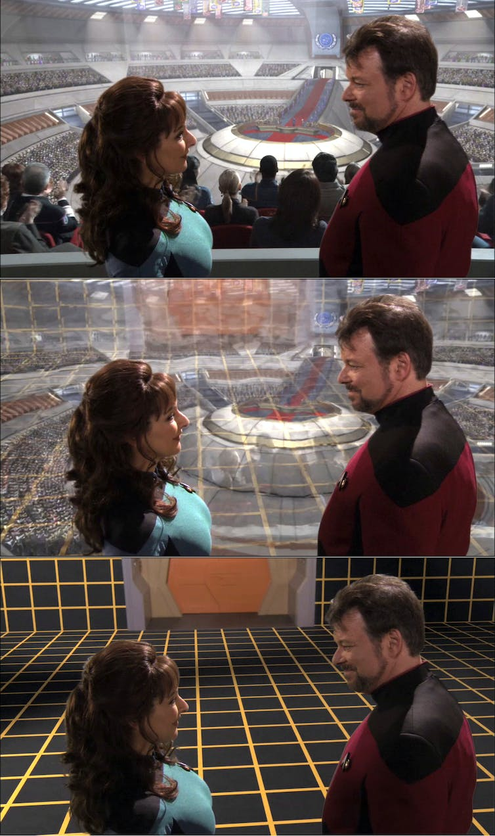
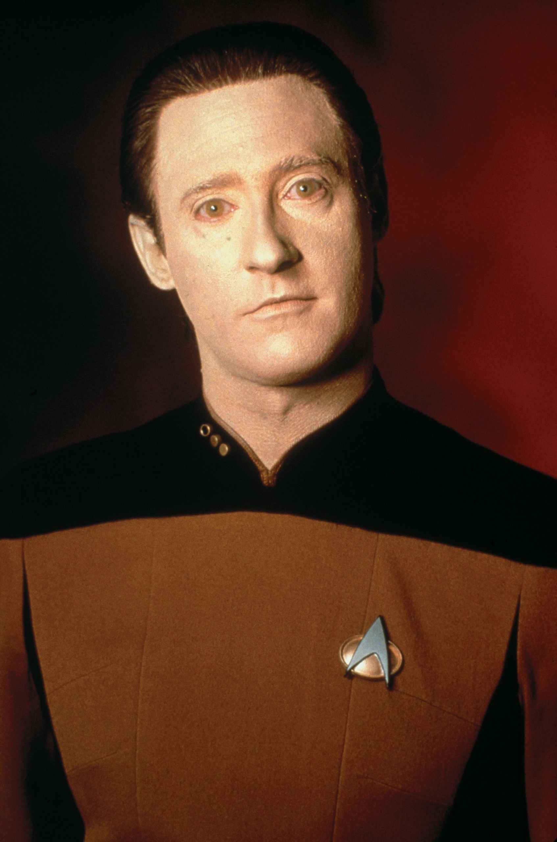
Generative AI – I grew up with it 😉
Source: https://www.fanpop.com/clubs/star-trek-the-next-generation/images/9406565/title/lt-commander-data-photo
Source: https://theconversation.com/star-treks-holodeck-from-science-fiction-to-a-new-reality-74839

Slide 5
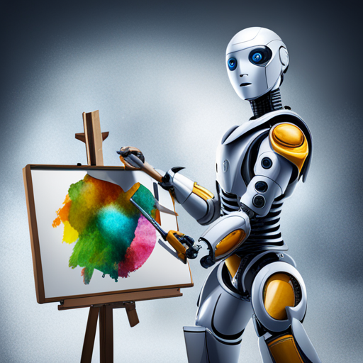
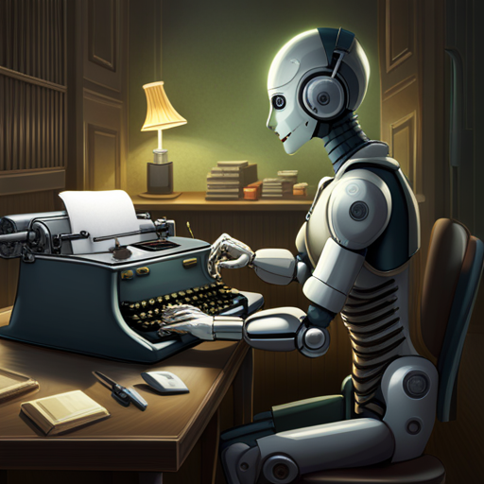
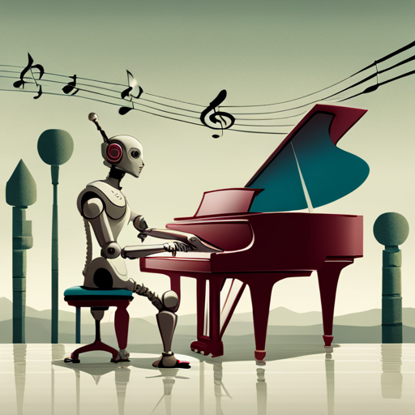
Generative AI – What is it?
AI that can produce original content close enough to human generated content for real-world tasks

Slide 6
How does it work (Text Generation Edition)?

Slide 7
Neural Networks Recap
Input:
x
Hidden States:
h
Output:
y

Slide 8
Recurrent Neural Networks Recap
Input:
…
x(t-1)
x(t)
x(t+1)
…
Hidden States:
…
h(t-1)
h(t)
h(t+1)
…
Output:
…
y(t-1)
y(t)
y(t+1)
…

Slide 9
RNNs are useful for text generation
This
is
good
Encoder
Decoder
Das
ist
gut

